Slide 1

Regression Predicting Boston House Prices

Slide 2

Topics
Regression Example
Network structure
Challenges
Normalizing the features
Small Dataset
K-Folding

Slide 3
The goal
Predict the median price of homes in a given Boston suburb in the mid-1970s, given data points about the suburb at the time, such as the crime rate, the local property tax rate, and so on.

Slide 4
The Dataset
506 records
404 training samples
102 test samples
13 numerical features (e.g. per capita crime rate, number of rooms, accessibility to highways)
Each feature in the input data (for example, the crime rate) has a different scale. For instance, some values are proportions, which take values between 0 and 1; others take values between 1 and 12, others between 0 and 100, and so on.

Slide 5
The Network structure
w1
w2
w3
Features
Loss - MSE
1
No Activation function
13
64
64
RelU
RelU

Slide 6
Normalizing the data
It is problematic to feed into a neural network values that all take wildly different ranges.
The network might be able to automatically adapt to such heterogeneous data, but it would definitely make learning more difficult.
Standard deviation normalization is very common

Slide 7
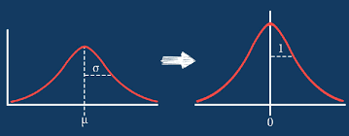
Standard Deviation Normalization
Standard deviation normalization: for each feature in the input, subtract the mean of the feature and divide by the standard deviation, so that the feature is centered around 0 and has a unit standard deviation

Slide 8
Standard Deviation Normalization Example
 | Flat Area | normalized
 | 100 | 0.35
 | 80 | -0.62
 | 105 | 0.59
 | 56 | -1.78
 | 122 | 1.41
 | 94 | 0.06
Avg | 92.83
Std | 20.71

Slide 9
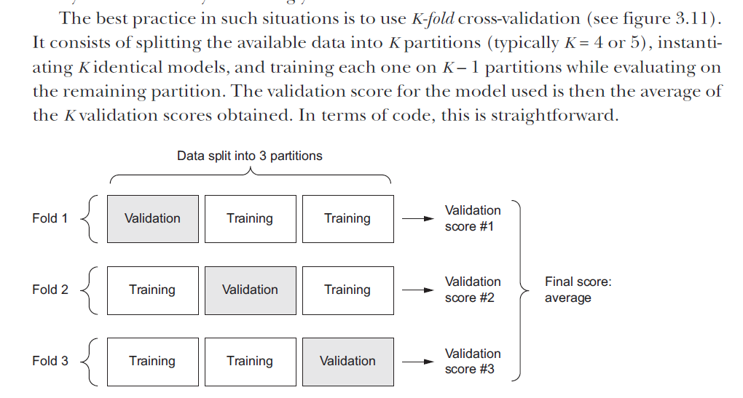
K-Fold for small Datasets

Slide 10
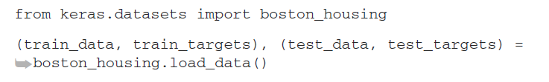
Process stages
Load the data
Prepare the data
https://github.com/fchollet/deep-learning-with-python-notebooks/blob/master/chapter04_getting-started-with-neural-networks.ipynb
Build the model
Train the network
Validate the results
Results on Test
Predict

Slide 11
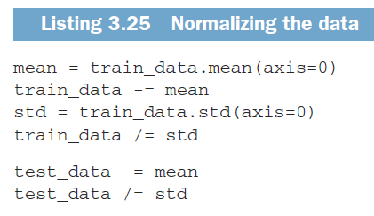
Process stages
Load the data
Prepare the data
Build the model
Train the network
Validate the results
Results on Test
Predict

Slide 12
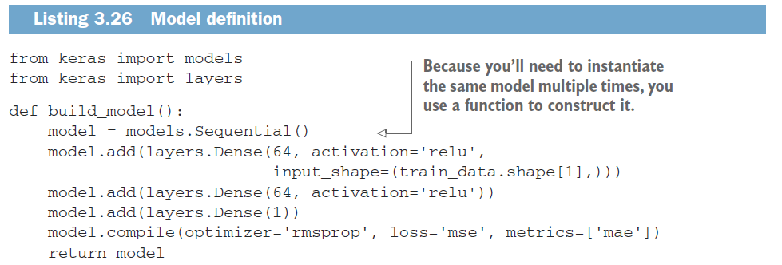
Process stages
Load the data
Prepare the data
Build the model
Train the network
Validate the results
Mean
Square
Errors
Mean
Absolute
Errors
Results on Test
Predict

Slide 13
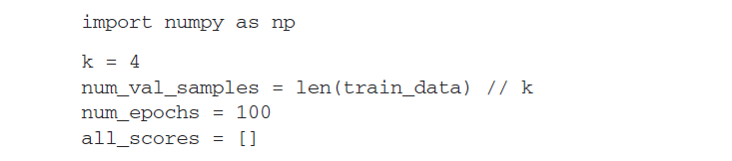
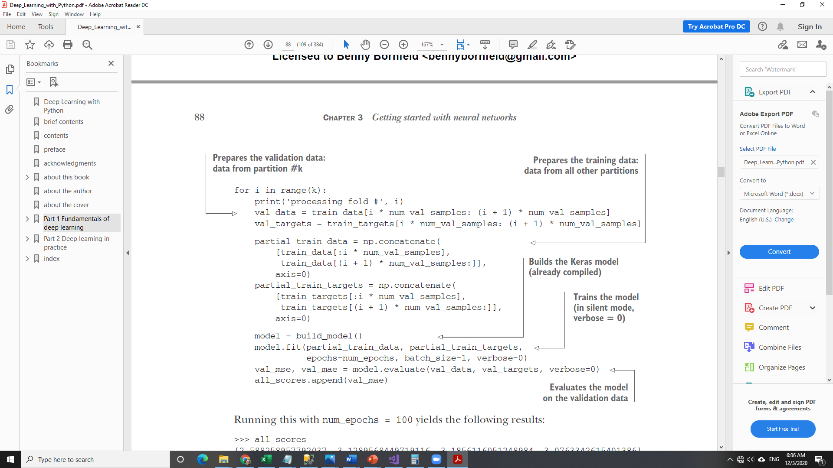
Process stages
Load the data
Prepare the data
Build the model
Train the network
Validate the results
Results on Test
Predict

Slide 14
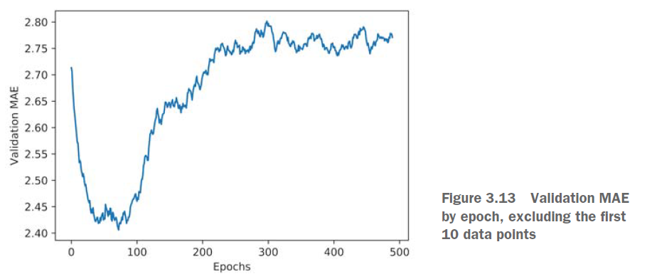
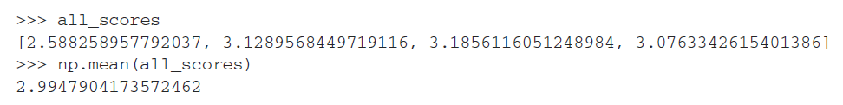
Process stages
Load the data
Prepare the data
Analyze the accuracy
First 10 were removed
Build the model
Train the network
Validate the results
Results on Test
Predict

Slide 15
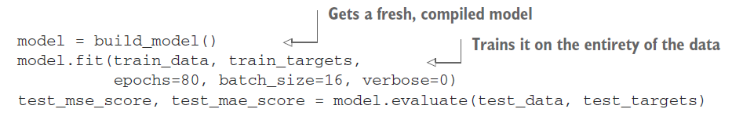
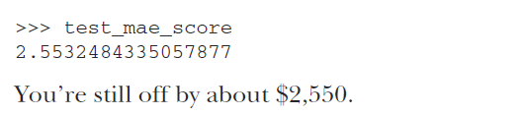
Process stages
Load the data
Prepare the data
Build the model
Train the network
Validate the results
Results on Test
Predict

Slide 16

Take Home Message
Mean squared error (MSE) is a loss function commonly used for regression.
Mean absolute error (MAE) is a common regression metric.
When features in the input data have values in different ranges, each feature should be scaled independently as a preprocessing step. (Normalizing)
When there is little data available, using K-fold validation is a great way to reliably evaluate a model.
When little training data is available, it’s preferable to use a small network with few hidden layers (typically only one or two), in order to avoid severe overfitting.

